Slide 1
Evaluating the Economic Impact of Federal Minimum Wage Increases in the U.S.
Capstone 3 Project Report
Andrew Call

Slide 2

The Minimum Wage Debate
Those who argue against Minimum wage increases often claim that they negatively impact other economic indicators.
What does the data say?

Slide 3
Stakeholders
Law/Policy Makers
Political Campaigns
Economists
Private Industry
Voters

Slide 4
Key Variables
Federal Minimum Wage Rate
Unemployment Rate
CPI (Consumer Price Index)
GDP per Capita
Median Personal Annual Income

Slide 5

The Data
Available quarterly Data
dating back to 1968 for all
Indicators but one.
Annual Data for median income
thru 1974

Slide 6
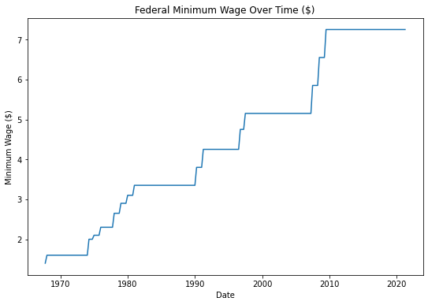

Slide 7
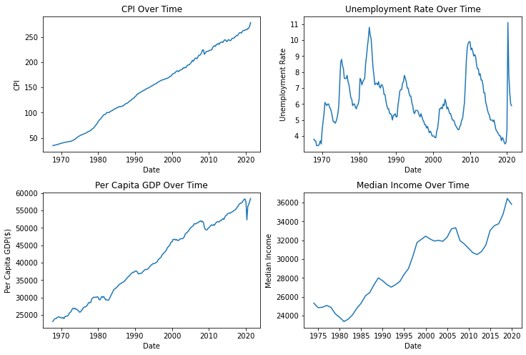
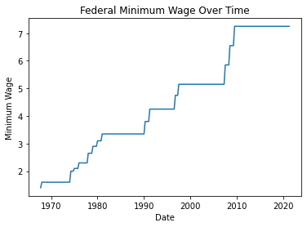

Slide 8
Objective
A/B Test
Quarters occurring within one year of a min wage increase
Quarters with no recent increase
Rate of Change

Slide 9
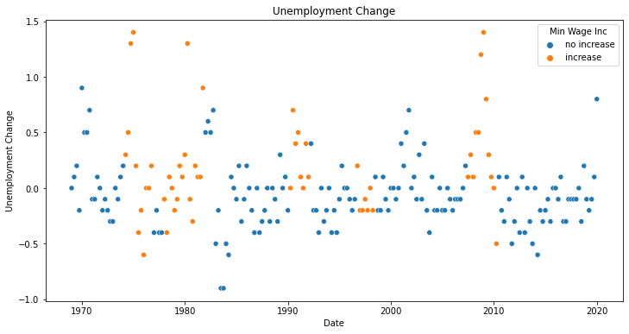

Slide 10
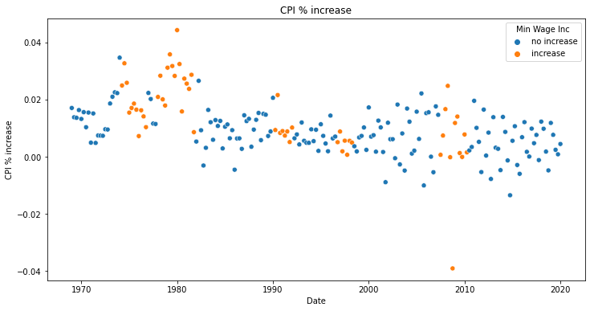

Slide 11
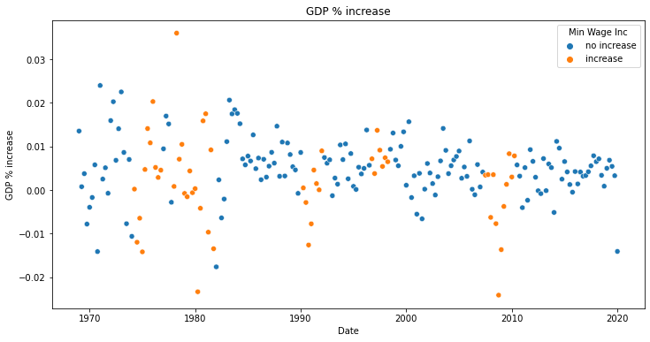

Slide 12
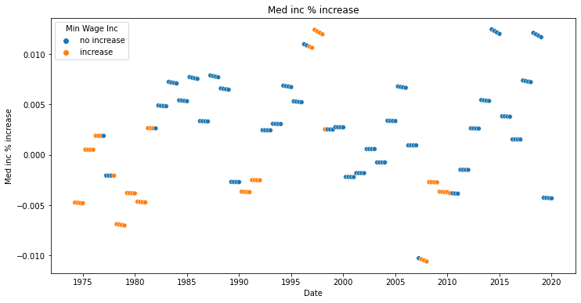

Slide 13
Null Hypothesis
The observed difference in means between periods of minimum wage increase and periods without is due to random occurrence
P-Value .01

Slide 14
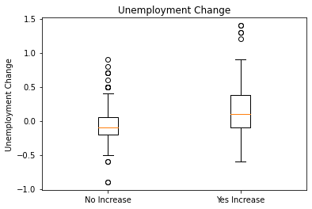
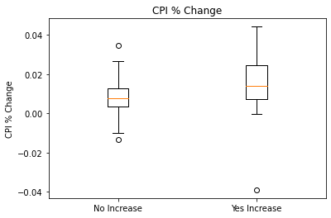
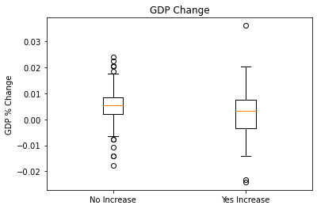
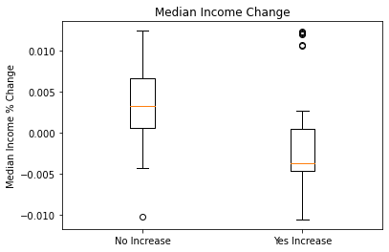

Slide 15
Observed Mean Differences
Unemployment Rate Change: 0.2724
CPI Increase: 0.0063
GDP Increase: 0.0033
Median Income Increase: 0.0048

Slide 16
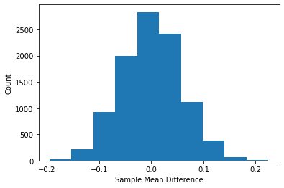
Unemployment Rate
Observed Mean
0.2724
P-Value
0.0
Reject Null

Slide 17
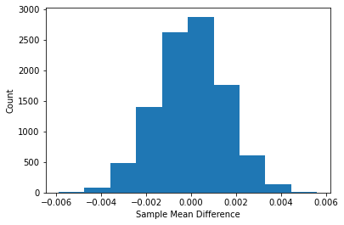
CPI
Observed Mean
0.0063
P-Value
0.0
Reject Null

Slide 18
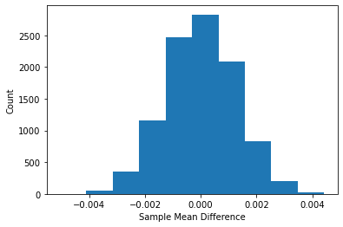
GDP
Observed Mean
0.0033
P-Value
0.0034
Reject Null

Slide 19
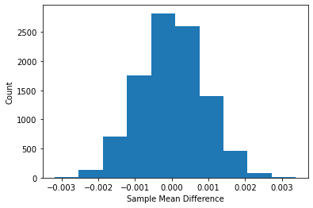
Median Income
Observed Mean
0.0048
P-Value
0.0
Reject Null

Slide 20
Final Conclusions
The difference in means for ALL 4 variables appears NOT to be simple randomness

